Slide 1
RETROSPECTIVA DE LA ESTRELLA
Comenzar a Hacer
Más de
Dejar de hacer
Seguir haciendo
Menos de
Notes:
--(This slide animates, next slide is same but static to enable linking)--
Many talent management suites on the market are composed of separate silos of functionality that are often stitched together
loosely from multiple code bases. But mySAP ERP HCM takes a different approach by providing a unified integrated view of
talent management processes for acquiring, motivating, and developing talent. It offers the most up-to-date global, integrated technology platform available for managing enterprise talent. It supports and integrates all talent management processes so you can attract, acquire, educate, and develop talent; identify and grow future leaders; and align and motivate talent with corporate objectives.
mySAP ERP HCM lets you create an advanced talent database – your talent warehouse – that enables recruiters to plan for, find,
track, and manage potential employees. Bringing selected candidates into your organization is simplified with flexible data
transfer into the solution. Using the latest technology and best practices, the solution helps you optimize your recruiting process. It lets you quickly find the right people and use their talents in the right place at the right time. You can perform comprehensive reporting and tracking of
applicants and candidates and use Web services to link to external recruiting resources such as job boards and online recruiting
service providers.
mySAP ERP HCM allows you to provide personalized learning programs based on individual job tasks, preferences, and existing knowledge. Employees and managers can pinpoint deficiencies in skill and knowledge and choose appropriate training programs to address them.
mySAP ERP HCM enables you to identify employees with high potential, track their progress, and create development plans to prepare them for leadership roles. You can also identify key positions and target specific employees as potential successors.
The analytical tools in the mySAP ERP application help define an organization’s key business objectives and let its HR department quickly produce unified performance plans that are operationally relevant and tailored for individual needs. The software provides a collaborative platform
where managers, employees, and peers can define and measure employee performance. mySAP ERP HCM lets you manage employee performance by integrating individual and team goals with corporate goals. You can also use the solution to link management-by-objective
documents directly to performance reviews, appraisals, and compensation administration. The solution makes it easy to manage compensation through reward strategies such as performance-based pay, variable-pay plans, and long-term incentive programs. You can also analyze and compare compensation packages to stay competitive with the marketplace.
mySAP ERP HCM gives your managers the insight they need to identify talent gaps and predict shortfalls based on anticipated changes in the business. By measuring and analyzing recruiting processes, succession programs, performance management processes, employee compensation programs, and learning programs (including attendance, usage, and links to operational data to determine program effectiveness) you receive valuable data that lets you refine your talent management abilities and plan for the future.

Slide 2
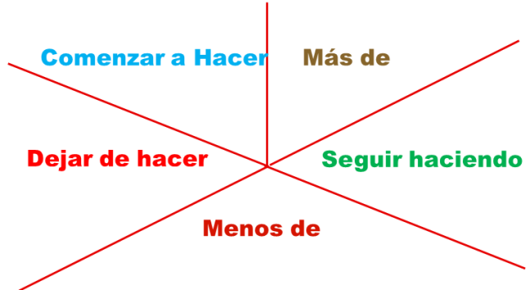
RETROSPECTIVA DE LA ESTRELLA
Comenzar a Hacer
Realizar instructivos detallados de configuraciones detalladas del Proyecto
Programar reuniones al menos 2 (dos) veces por semana
Utilizar estándares “End-Points” de REST

Slide 3

RETROSPECTIVA DE LA ESTRELLA
Más de
Más de …
Utilizar GITHUB para verificar a través de PR el código de los compañeros.
Mejorar comunicación dentro del grupo para solucionar inconvenientes técnicos encontrados
Documentar código realizado.
Notes:
3

Slide 4



RETROSPECTIVA DE LA ESTRELLA
Dejar de hacer
Esperar a la reunión para solucionar problemas que se presentaron con anterioridad.
Realizar cambios que impacten al proyecto a último momento.
Microsoft .
Instalar dependencias sin que estén en el POM o package.config.
Notes:
4

Slide 5
RETROSPECTIVA DE LA ESTRELLA
Seguir haciendo
Investigar alternativas que faciliten
implementación de la solución
Seguir implementando la solución
Alineados con conceptos aprendidos
en clases
Continuar utilizando nuevas tecnologías
Seguir haciendo

Slide 6
Desarrollo de Personal
Menos de
Trabajar en forma individual
Desarrollo de personal
Utilizar Jquery dentro del proyecto
Notes:
6

